Slide 1
Smart Railway Management System
Algorithmic Logic and Data Structure design
Presenter: Axit Kandwal
Roll No: 005 | AI Department

Slide 2

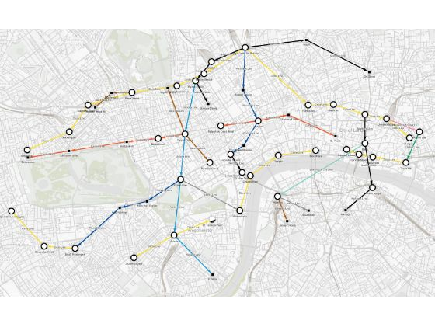
The Foundation: Smart Railways
Automation in railways is a complex orchestration of database state and memory-resident logic.
Registration & Secure Authentication
Real-time Status Monitoring
Autonomous Seat Allocation

Slide 3
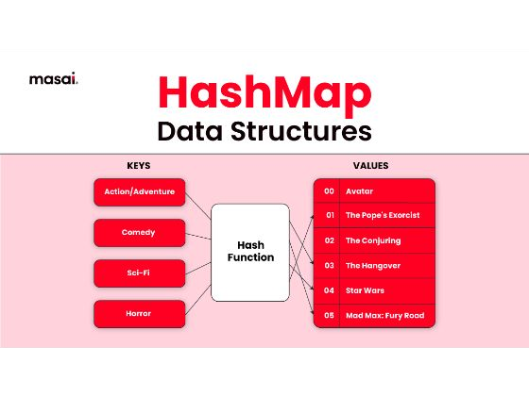

Key-Value Optimization
We leverage Python Dictionaries to eliminate redundant DB calls.
O(1) Lookup
Caching station_cache and train_cache ensures immediate UI rendering.

Slide 4
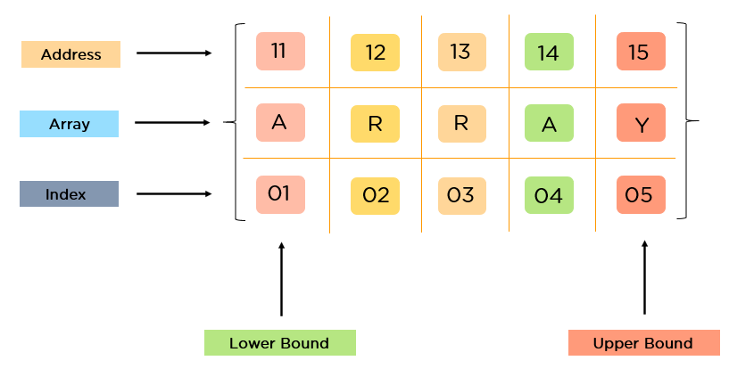
Linear Processing & Accumulation
Arrays serve as the primary mechanism for multi-passenger bookings.
Lists: Accumulating route segments to calculate dynamic fares.
Tuples: Immutable database rows from fetchone()
for safety.

Slide 5
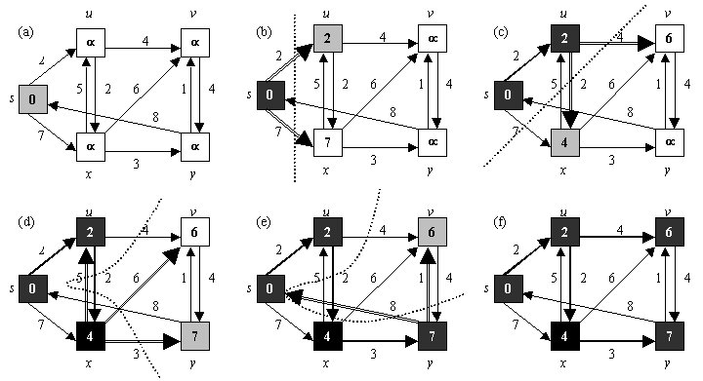
Routing Logic: Dijkstra
The cheapest route is found by exploring nodes with minimal weight.
Building Graph via Adjacency Lists.
Min-Heap for Greedy Exploration.
Optimal path reconstruction.
Time Complexity = O((V+E)*log V)

Slide 6
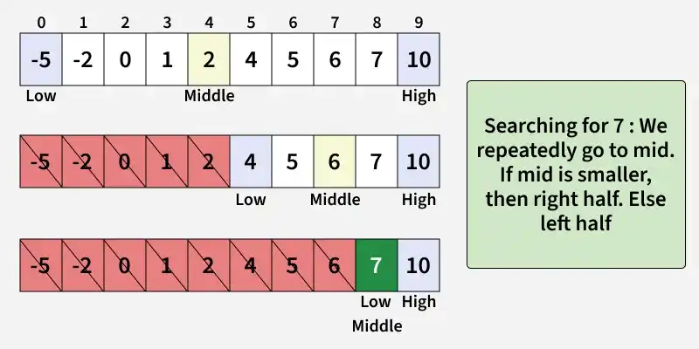

Logarithmic Search: Binary
Instead of Linear Search O(n), we implement Binary Search O(log n).
Splitting sorted lists significantly improves search performance during train identification.

Slide 7
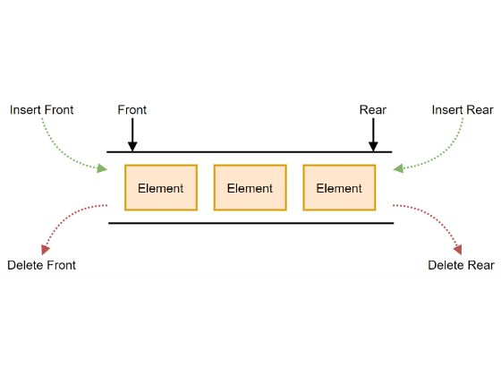
Waitlist Queuing: Deque
Standard lists are O(n) for dequeuing. We use
collections.deque for O(1) operations.
This handles FIFO booking requests without performance degradation as waitlists grow.

Slide 8
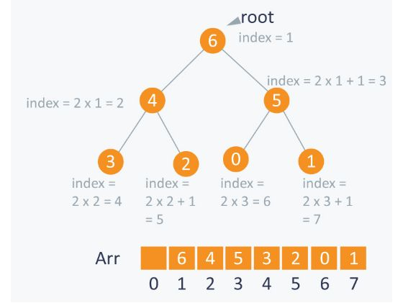
Priority Scheduling: Heap
Priority Queues manage seat promotion logic for senior citizens.
Priority 0: High Priority (Seniors).
Priority 1: Standard.

Slide 9
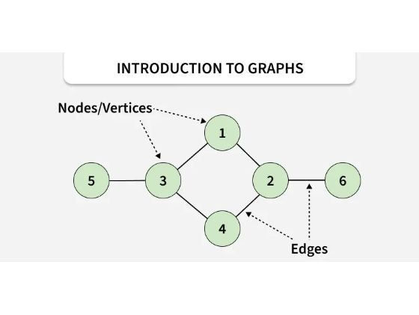
Data Integrity: Set & OrderedDict
Sets handle membership checks in O(1) for visited nodes.
OrderedDict ensures that passenger summaries are stored and displayed in insertion order for receipt generation.

Slide 10
System Integrity & Conclusion
Our implementation balances time-efficiency with data correctness.

